Slide 1

Staff Working Document
Combatting hiv/aids, viral hepatitis and Tuberculosis
Jean-Luc SION
SANTE C3 Crisis management and preparedness in health

Slide 2
Scope
The SWD will
highlight policy frameworks, approaches, guidance, experiences and best practices that were used, transposed and adapted to help Member States improve their response and reach the Sustainable Development Goals.
support decision makers, stakeholders, and interested citizens with an overview of policies, approaches, guidance, experiences and best practices that have proven to generate impact on HIV/AIDS, viral hepatitis and tuberculosis prevention, control and treatment.
Source: ECDC. Monitoring implementation of the Dublin Declaration on Partnership to Fight HIV/AIDS in Europe and Central Asia. 2016. (unpublished data)

Slide 3



Sustainable Development Goal 3.3.

Slide 4
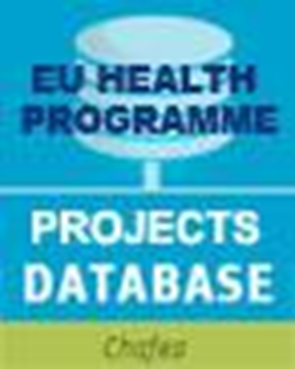
EU policy instruments
Several EU policy instruments could be mobilized to combat HIV/AIDS, viral hepatitis and tuberculosis:
Public Health
  Decision 1082 on serious cross-border
  threats to health
  Think Tank and Civil Society Forum
  Health Programme
Source: ECDC. Monitoring implementation of the Dublin Declaration on Partnership to Fight HIV/AIDS in Europe and Central Asia. 2016. (unpublished data)

Slide 5
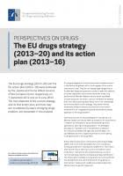

EU policy instruments
Several EU policy instruments could be mobilized to combat HIV/AIDS, viral hepatitis and tuberculosis:
EU Drugs Strategy and Programme
Research Programmes
Source: ECDC. Monitoring implementation of the Dublin Declaration on Partnership to Fight HIV/AIDS in Europe and Central Asia. 2016. (unpublished data)

Slide 6


EU policy instruments
Several EU policy instruments could be mobilized to combat HIV/AIDS, viral hepatitis and tuberculosis:
Development Cooperation Policy
  EU Health Sector Development Policy – New European Consensus on Development
  Support to Global Fund to fight HIV/AIDS, Tuberculosis and Malaria
  Universal Health Coverage
Source: ECDC. Monitoring implementation of the Dublin Declaration on Partnership to Fight HIV/AIDS in Europe and Central Asia. 2016. (unpublished data)

Slide 7
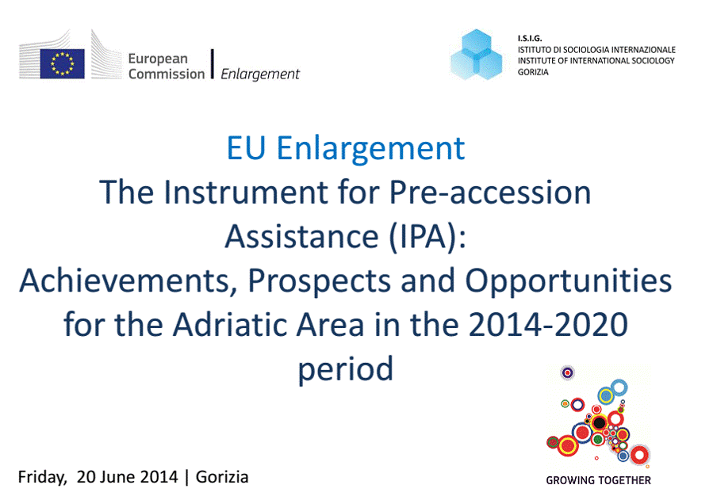
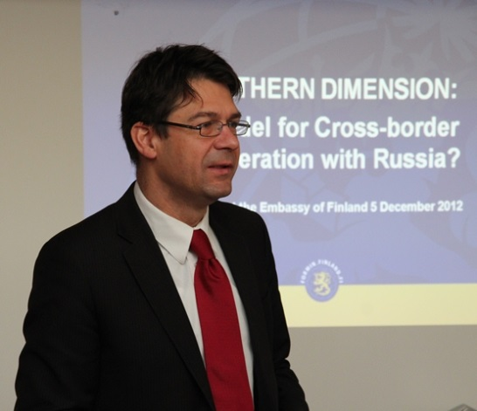

EU policy instruments
Several EU policy instruments could be mobilized to combat HIV/AIDS, viral hepatitis and tuberculosis:
Accession, Neighborhood Policy and External Relations
  Instrument for Pre-accession Assistance (IPA)
  European Neighborhood Policy (ENP)
  The Northern Dimension (EEAS)
Source: ECDC. Monitoring implementation of the Dublin Declaration on Partnership to Fight HIV/AIDS in Europe and Central Asia. 2016. (unpublished data)

Slide 8

EU policy instruments
Several EU policy instruments could be mobilized to combat HIV/AIDS, viral hepatitis and tuberculosis:
EU Structural and Investment Funds (ESIF)
  ESIF comprise five main Funds which are not intended to replace national, regional and local investments in the Member States, however instead to provide co-funding for such investments.
  The investments in health in the Member States come solely from the funds ERDF and ESF within the national and regional Operational Programmes (OPs) adopted in the individual Member States.
Source: ECDC. Monitoring implementation of the Dublin Declaration on Partnership to Fight HIV/AIDS in Europe and Central Asia. 2016. (unpublished data)

Slide 9
Best practices and specific actions
Several types of actions have contributed to the tackling of HIV/AIDS, viral hepatitis and tuberculosis:
Technical guidance to tackle the epidemics by ECDC and EMCDDA
  HIV and STI prevention among men who have sex with men
  Systematic review on the diagnosis, treatment, care and prevention of tuberculosis in prison settings
  Prevention and control of infectious diseases among people who inject drugs
Source: ECDC. Monitoring implementation of the Dublin Declaration on Partnership to Fight HIV/AIDS in Europe and Central Asia. 2016. (unpublished data)

Slide 10
Best practices and specific actions
Several types of actions have contributed to the tackling of HIV/AIDS, viral hepatitis and tuberculosis:
Best practice implemented through the EU Health Programme
  Early diagnoses of HIV, viral hepatitis and tuberculosis
  Integration of treatment and care
  Civil society involvement in the response
Source: ECDC. Monitoring implementation of the Dublin Declaration on Partnership to Fight HIV/AIDS in Europe and Central Asia. 2016. (unpublished data)

Slide 11
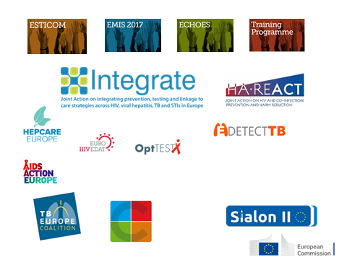

Slide 12
Available at
https://ec.europa.eu/health/sites/health/files/communicable_diseases/docs/swd_2018_387_en.pdf

Slide 13
Thank you!

